Slide 1
newRPL
A new twist on RPL

Slide 2
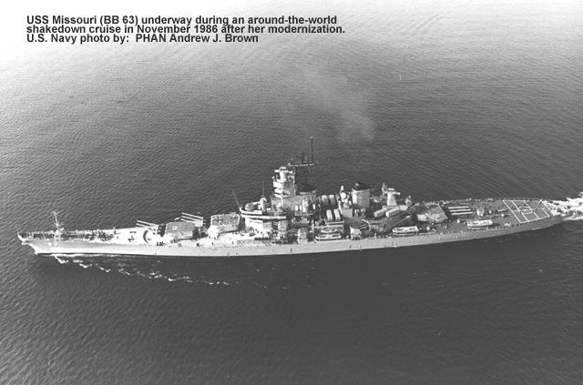
HP-50G
What is it?

Slide 3

HP-50G
What is it?
Released by US-Navy

Slide 4

HP-50G
What is it?
photographed by Hans-Juergen Hamann
Wiki-Commons

Slide 5

newRPL
A new twist on RPL
NewRPL
Author: Claudio L. (HPGCC3 Project)
Rewrite RPL for the HP50G from scratch → CL50NR
Native ARM-code instead of emulating the Saturn
Compatibility to legacy user RPL
Improve performance and usability
http://hpgcc3.org

Slide 6
newRPL – CL50NR
A new twist on RPL
NewRPL
Intended improvements
  Speed increase
  Adjusted user interface
  More versatile numbers
  New functionalities
  Portability

Slide 7
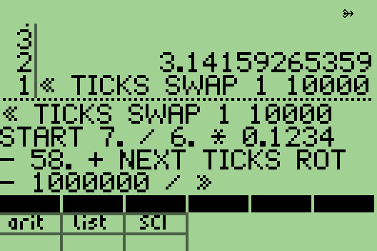
newRPL – CL50NR
Speed
Simple arithmetic
  „+“ „-“ „× “ „ ÷“ only
  3.14159265359
  << TICKS SWAP 1 10000 START 7. / 6. * .1234 – 58. + NEXT TICKS ROT – 1000000 / >>
  TICKS handled differently
  HP50G~79.6s CL50NR~1.3S →~60x

Slide 8
newRPL – CL50NR
Speed
8-Queens
  UserRPL = 22.6 seconds.
  newRPL = 106 ms →~210x
http://www.hpmuseum.org/cgi-sys/cgiwrap/hpmuseum/articles.cgi?read=700

Slide 9
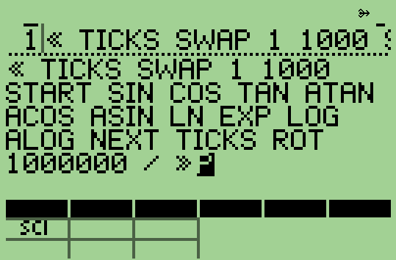
newRPL – CL50NR
Speed
Scientific functions
  CL50NR set to 16 digits precision
  9 << TICKS SWAP 1 1000 START SIN COS TAN ATAN ACOS ASIN LN EXP LOG ALOG NEXT TICKS ROT 1000000 / SWAP >> 9 -
  HP50G~79.33s CL50NR~17.13s
  HP50G ~1.357E-6 off
  CL50NR ~2.93E-11 off
  Speed factor ~4.6x

Slide 10
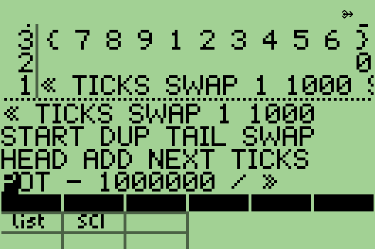
newRPL – CL50NR
Speed
Lists
  {1 2 3 4 5 6 7 8 9}
  << TICKS SWAP 1 1000 START DUP TAIL SWAP HEAD ADD NEXT TICKS ROT - 1E6 / >>
  Note: „+“ and „ADD“ exchanged
  HP50G ~12.8 sec CL50NR~0.53 →~24x
  Size increased to 72 Elements
  HP50G ~21.8 sec CL50NR~0.69 →~31x
  HP50G ~+70% CL50NR ~+30%

Slide 11

newRPL – CL50NR
User interface
  WYSIWYG – not always

Slide 12
newRPL – CL50NR
User interface
  WYSIWYG – not always

Slide 13
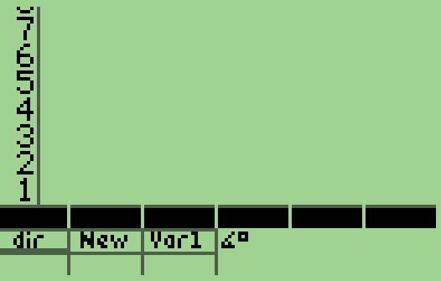
newRPL – CL50NR
User interface
Additional menu
    6 keys left of arrows losing their functions
    First and second menu switchable
    Long press shows content
    These keys lose their original functions
    STO – RCL mapped to HIST key
    Others will be mapped elsewhere
    Swap menus
    Toggle 2nd menu on/off

Slide 14
newRPL – CL50NR
User interface
Arrows functions
  Input mode
    Left → undo (8 levels)
    RS left → redo
    LS up → UPDIR
    LS (hold) up → HOME
  Edit mode
    LS left → BEGIN
    LS right → END
    LS (hold) left → COPY
    LS (hold) right → PASTE
    LS (hold) down →CUT

Slide 15
newRPL – CL50NR
User interface
ON as shift key
  ON + “+” or “-”
    change contrast
  ON + SPC
    toggle STD ,FIX ,SCI , ENG
  ON + “0” – ”9”
    set number of digits
  ON + Dot
    toggle formats
  ON + “÷” or “×”
    ENG change exponent
  ON + VAR or VAR(hold)
    Swap menus
    Hide or show 2nd Menu

Slide 16
newRPL – CL50NR
User interface
Alpha Key toggles
  Capital letters
  Lower case
  Direct entry or
  Program entry
Shifted Alpha available
  RS 6 “∡” LS 6 “ ° ”
  LS (hold) 6 “ ⁶ “
C
L
D
P

Slide 17
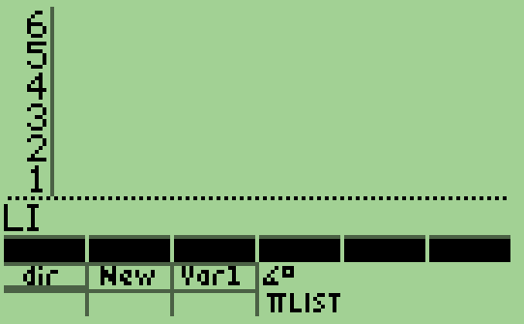
newRPL – CL50NR
User interface
Auto completion
  Start typing a command
  Match shows up in status area
  Scroll through available commands
    Hold ALPHA and press Down or Up
  Limit search by additional letter
  Select command
    Hold ALPHA + right arrow
  Not in alphabetical order

Slide 18
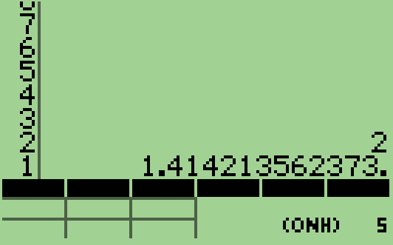
newRPL – CL50NR
Numbers
Real Numbers
  Precision up to 2000 digits
  Exponent up to ± 30000
  Approximate Numbers
    e.g. SQR(2)
    Denoted by a trailing dot
  Exact numbers
    e.g. 3 / 2 = 1.5
Integer (Binary) Numbers
  Base 2,8,10,16
  e.g. #1010b #FFFh #126o

Slide 19
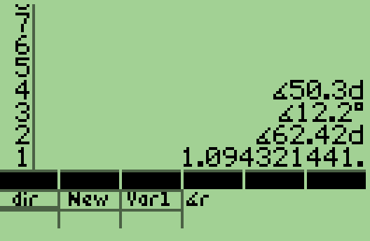
newRPL – CL50NR
Angles
Different Modes
  Shown in the status area
  DEG → ∡°
  GRAD → ∡g
  RAD → ∡r
  DMS → ∡d
Override by tagging
  ∡90°
  ∡90g
  ∡3r
  ∡77.2630d
  ∡50.30d+∡12.20° = ∡62.42d

Slide 20
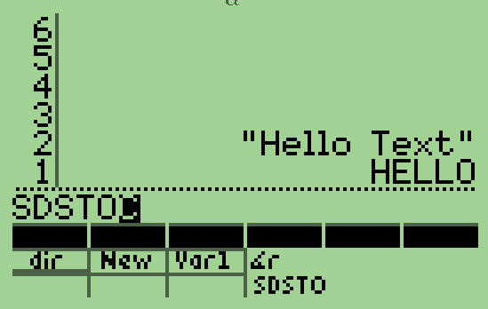
newRPL – CL50NR
SDCARD
Up to 4 partitions (0-3) even SDHC
Create/Purge Directories &Files
Interact with Directories & Files
Distinguish lower and capital characters in names
Get DOS like information
SDSTO / SDRCL
  ‘VAR’ or “mydir/MyFile” or{HOME ‘mydir’ ‘MyFile’

Slide 21
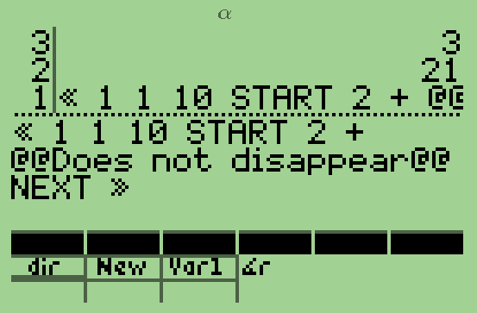
newRPL – CL50NR
Programming
Variables accessed fast
Local Vars lightning fast
LSTO / LRCL
Persistent comments
  @this is a volatile comment@
  @@this is a persistent comment@@

Slide 22
newRPL – CL50NR
Portability
newRPL – CL50NR
Portability
3 layers - 99% C 1% RPL
newRPL language core
  Hardware independent
  Easily portable
Hardware abstraction layer
  Almost identical for all platforms
  But small adjustments necessary
Hardware interface
  Completely hardware dependent
  Hardware boot code, drivers

Slide 23
newRPL – CL50NR
Status
newRPL – CL50NR
Status
NewRPL is ALPHA Software
A usable calculator
A Joy to explore
Menus available?
  Only units and
  TMENU
>200 Functions implemented
Continuously growing

Slide 24
newRPL – CL50NR
The way ahead
newRPL – CL50NR
The way ahead
Claudio will continue (Some help?)
YOU
  Rush out, get a HP 50G for newRPL
  Or flash the one you have. It is reversible, don’t worry.
HP
  Consider to adopt newRPL for PRIME
SwissMicros
  Evaluate platform for newRPL

Slide 25
newRPL – CL50NR over the horizon
newRPL – CL50NR
over the horizon
Released by US-Navy

